Slide 1
The NCI's Provocative Questions Initiative: Program Overview and Current Opportunities
Emily J. Greenspan, Ph.D.
Program Director
Center for Strategic Scientific Initiatives (CSSI)
Office of the Director, National Cancer Institute (NCI)
National Institutes of Health (NIH)
September 2015

Slide 2

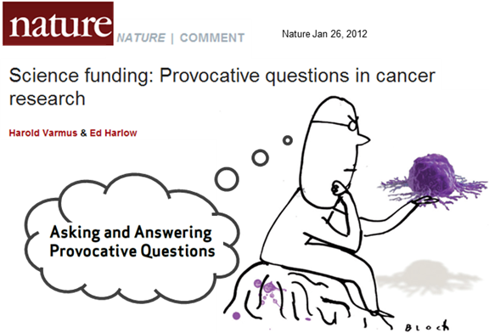
Provocative Questions Overview
Program Objective:
Stimulate specific areas of cancer research that are deemed understudied, neglected, paradoxical, or have been difficult to address in the past.
Requests for Applications (RFAs) issued in:
2011, 2012, 2013 [Phase 1] and 2015 [Phase 2]
PQs solicited through workshops with the extramural research community and website
R01 and R21 grant mechanisms
Preliminary data for R01s de-emphasized
Projects encouraged to move beyond next logical
or incremental step
Varmus and Harlow. Nature 2012; 481: 436-437
Notes:
Overview of PQ Initiative, initiated by Dr. Varmus in 2010/2011 to focus on understudied areas of cancer research.
RFAs issued to hit objectives. 1st 3 issuances in 2011-2013 = 1st phase, 2015 issuance = start of 2nd phase
PQ solicited through extramural…questions constantly evolving with workshops held before each reissuance of the RFA…Don’t encompass the priorities of the NCI, but do cover many problems spanning different fields… spanning laboratory, clinical and populations sciences…innovative approach to work with research community to identify key questions in cancer research.
In response to a selected PQ, investigators submitted R01 – research project grant; R21 – exploratory grant
New/understudied research areas, preliminary data de-emphasized
Outside the box research, beyond incremental advances from investigator’s research track
Article from Dr. Varmus and Harlow about motivations behinds program and early responses….
Program renewed in 2014, new 2015 RFAs published at end of March 2015…I’ll talk through some outcomes of the 1st phase and then present the new opps. for the 2nd phase

Slide 3
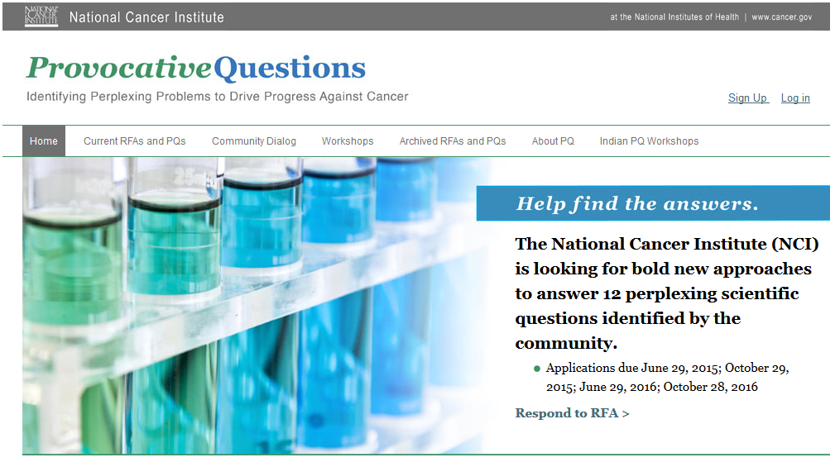
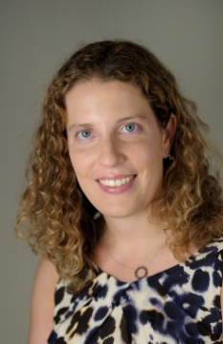
Provocative Questions (PQ) Coordination
Program Director
Emily J. Greenspan, Ph.D.
provocativequestions.nci.nih.gov
Notes:
Program Director Emily Greenspan (session moderator), I work as Project Manager. Major role is to talk with applicants, discuss research, and how it matches with the funding opportunity. For these programs and other NIH programs, recommend talking to program officer.

Slide 4
PQ Trans-NCI Organizational Structure
Center to Reduce Cancer Health Disparities
CSSI
CRCHD
DCP
DCCPS
DCB
DCTD
Division of Cancer Biology
Division of Cancer Prevention
Program Director
Emily J. Greenspan, PhD
Division of Cancer Treatment and Diagnosis
Division of Cancer Control and Population Sciences
Notes:
Topical areas of questions range from basic, translation, clinical, and population research.
Due to the breadth of science covered, program operates across the NCI, pulling in expertise from a variety of NCI Divisions

Slide 5
PQ Timeline – Phase I
Implementation
2011 RFAs: 24 PQs solicited through workshops with the extramural research community and website
2012 RFAs: revised set of 24 PQs, 2 receipt dates
2013 RFAs: revised set of 20 PQs, 2 receipt dates
May 2012 NCAB
*56 awards*
May 2013 NCAB
*29 awards*
Jan. 2014 NCAB
*64 awards*
Aug. 2014 NCAB
*19 awards*
Jan. 2015 NCAB
*20 awards*
2011 RFA
Applications due
2012 RFA,
1st Receipt
Applications due
2012 RFA,
2nd Receipt Applications due
2013 RFA,
1st Receipt Applications due
2013 RFA,
2nd Receipt
Applications due
2011 RFAs published
(CA-11-011 &
CA-11-012)
2012 RFAs published
(CA-11-015 through
CA-12-022)
2013 RFAs published
(CA-13-016 through
CA-13-025)
Program Renewed
2011
2012
2013
2014
2015
Ongoing Evaluation
2011 RFAs
Evaluation
Logic Model
Development
2011-2012 RFAs
Evaluation
2011-2013 RFAs
Evaluation
Thomson Reuters and NCI’s Office of Science Planning and Assessment (OSPA)
Hsu et al. Res Eval 2013; 22: 272-284
Notes:
RFAs published, application receipts, awards…still one more round of awards to be made from applications submitted in June 2014.
Running parallel to the application/award process, the PQ Initiative has being undergoing an evaluation. 1) To determine how the program is aligning with its goals, 2) inform programmatic changes and new PQs…Constantly evaluating how the review and programmatic process…Publication on preliminary evaluation in 2013…
Bolstered by the evaluation, program was approved for renewal by NCI leadership in 2014. Estimate new RFAs in spring 2015. Workshops in progress…

Slide 6
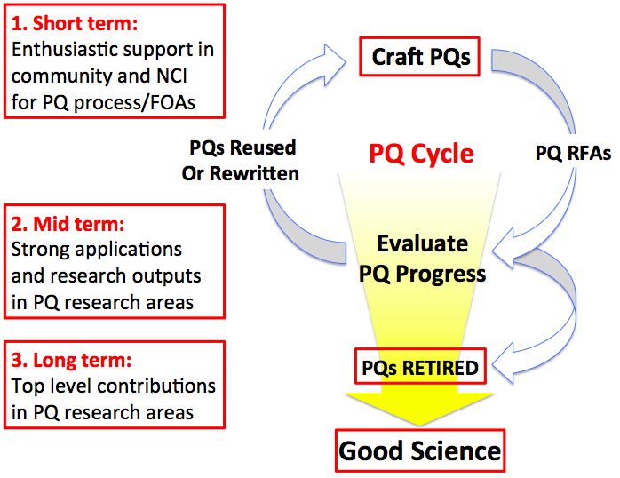
Goals and Metrics of Success
Adapted from Ed Harlow
Notes:
Question development process guided by short, mid, long term goals. Short-term: enthusiasm in res. community/NCI for PQ development and FOAs. Mid-term: strong applications addressing the questions and research outputs through pubs, grants, etc.; Long-term: progress in these understudied research areas. Questions also removed to make way for new ideas. Some outcomes to date…

Slide 7
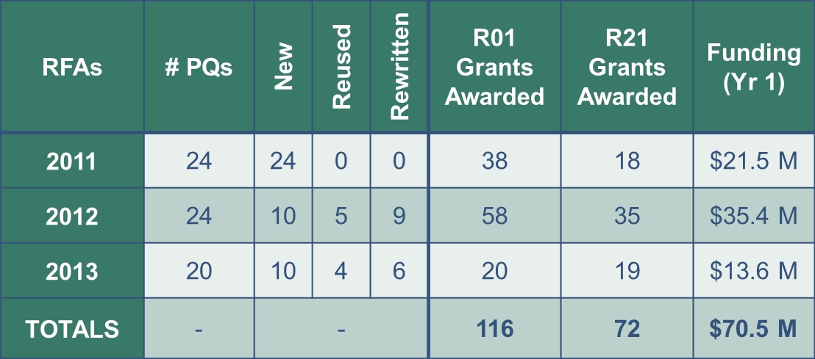
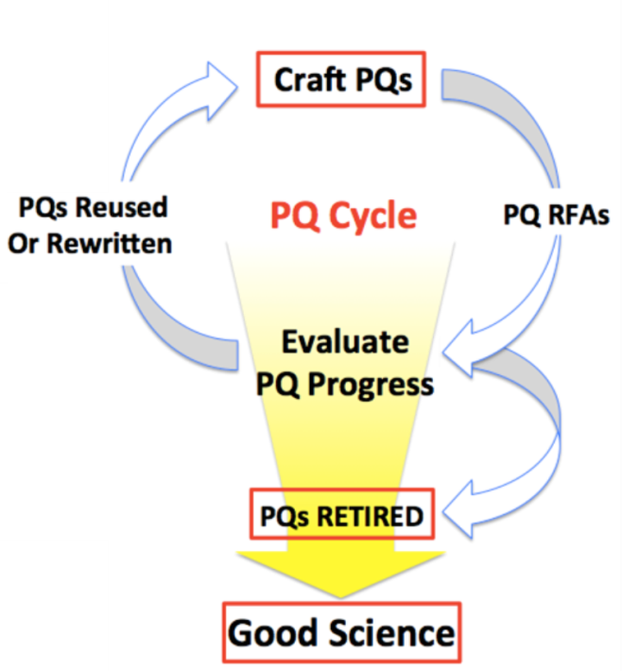
Overall Phase I Program Outcomes
Since the Initiative’s inception the NCI has awarded 188 unique R01 and R21 grants totaling over $70 million in 1st year support

Slide 8
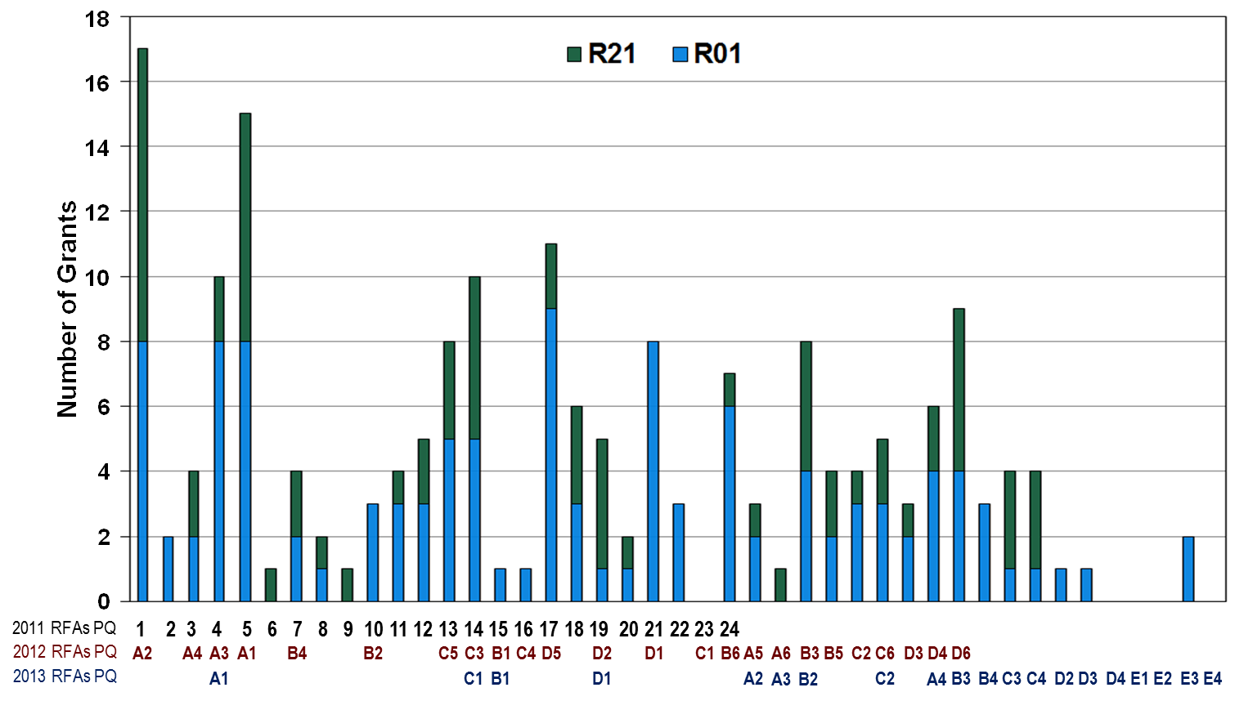
PQ Awards To Date (2011 - 2013 RFAs)
PQ1/A2: How does obesity contribute to cancer risk?
PQ5/A1: Given the evidence that some drugs commonly and chronically used for other indications…can protect against cancer incidence and mortality, can we determine the mechanism by which any of these drugs work?
Notes:
Awards are made based on the merit of the grants…no even distribution among PQs or grant mechanism
Numbering system changed from 2011 – 2013 RFAs….first list of 24 questions, then questions were groups thematically (Group A, B….)…
Multiple listings under a column = same question or updated version of question repeated in subsequent RFAs…3 numbers = included in 2011-2013 RFAs
Most funded awards to PQ1 (obesity and cancer risk); PQ5 (drugs for other indications…such as aspirin and cancer risk)

Slide 9
PQ Awards To Date (2011 - 2013 RFAs)
PQ23/C1: Can we determine why some tumors evolve to aggressive malignancy after years of indolence?
PQD4: What are the mechanistic bases for differences in cancer drug metabolism and toxicity at various stages of life?
PQE1: What strategies optimize adoption and sustainability of guideline concordant cancer treatments in community settings?
PQE2: What care delivery models can be developed to transition cancer patients effectively from active therapy to end of life care?
PQE4: What are the best methods to identify and stratify subgroups of patients with particular co-morbidities who will benefit from defined cancer therapies?
Notes:
On other hand, some questions received a less robust response….failed to fund awards for 5 questions
Possible reasons: 1) Field not ready, 2) Appropriate researchers not aware, 3) Something missing to progress forward in that area (ex: cohorts), 4) Phrasing of question
In 2013, introduced new group of questions on clinical effectiveness – limited response, may be due to advertising and failure to reach appropriate audience

Slide 10
Who Is Applying – Discipline and Previous Applications?
Investigator Discipline – 2011 RFAs | % of PQ Applicants
Basic/life sciences | 47.7
Behavioral | 1.6
Epidemiology | 2.1
Physical science/engineering | 13.3
Clinical sciences – MD | 15.3
Clinical sciences – MD/PhD | 20.0
* NIH awarded FY09 PIs: ~28% MD or MD/PhD
* NCI R01/R21 FY12 applicants: ~30% MD or MD/PhD
Hsu et al. Res Eval 2013; 22: 272-284
Percentile Relative to NCI’s 2010 Funding Opportunities – 2011 & 2012 RFAs
Applicant Category | R01 |  | R21
 | Percent of Applications | R01 Percentile | Percent of Applications | R21 Percentile
New Investigator (NIH Definition) | 31.1% | 47th | 50.0% | 28th
First NCI Application | 14.5% | 54th | 22.9% | 56th
First NIH Application | 6.0% | 63rd | 10.8% | 52nd
PQ calculations based on the median over all RFAs within initiative.
“New Investigator” status was calculated for each investigator using rules defined by NIH: grants.nih.gov/grants/new_investigators/#definition
Notes:
NIH New Investigator: no previous major award (such as an R01); Most metrics are on par with the NCI FOAs.
NIH FY12 R01 awardees: ~27% New Investigator/Early Stage Investigator
NCI FY12 R01 applications: ~31% New Investigator/Early Stage Investigator

Slide 11

Overall Phase I Program Outcomes
NCI has awarded 188 unique R01 and R21 grants totaling over $70 million in 1st year support
Continued enthusiasm for PQ RFAs and PQ process
New investigators are applying
Novel applications received (PQ-dependent)
Ongoing evaluation will encompass 2011-2013 RFAs
Focus on application novelty, characterization of applicants, measures of research growth in PQ-areas
Include interviews with applicants, awardees, and program officials

Slide 12
Phase II Kickoff – 2015 RFAs [CA-15-008 and CA-15-009]
RFAs Published: March 27, 2015
1st Receipt:
June 29, 2015
2nd Receipt: October 29, 2015
3rd Receipt: June 29, 2016
4th Receipt:
October 28, 2016
R01: RFA-CA-15-008; R21: RFA-CA-15-009
Workshops with extramural community in fall/winter
PQs finalized in spring
12 PQs – 7 New and 5 Reused/Rewritten
Letters of Intent (LOIs) encouraged 30 days before receipt dates

Slide 13
Changes for 2015 RFAs
RFAs Published: March 27, 2015
1st Receipt:
June 29, 2015
2nd Receipt: October 29, 2015
3rd Receipt: June 29, 2016
4th Receipt:
October 28, 2016
New to these RFAs:
R01 total project period extended to 5 years (was 4 years)
Resubmissions (A1) of applications originally submitted to these RFAs allowed (not previously allowed)
Intent Statements outline requirements for scientific responsiveness

Slide 14

New Questions 1
PQ1: For tumors that arise from a pre-malignant field, what properties of cells in this field can be used to design strategies to inhibit the development of future tumors?
PQ2: What molecular mechanisms influence disease penetrance in individuals who inherit a cancer susceptibility gene?
PQ3: How do variations in tumor-associated immune responses contribute to differences in cancer risk, incidence, or progression?
PQ4: Why do some closely related tissues exhibit dramatically different cancer incidence?

Slide 15
New Questions 2
PQ5: How does mitochondrial heterogeneity influence tumorigenesis or progression?
PQ6: What are the underlying molecular mechanisms that are responsible for the functional differences between benign proliferative diseases and premalignant states?
PQ7: What in vivo imaging methods can be developed to determine and record the identity, quantity, and location of each of the different cell types that contribute to the heterogeneity of a tumor and its microenvironment?
PQ8: What cancer models or other approaches can be developed to study clinically stable disease and the subsequent transition to progressive disease?

Slide 16
New Questions 3
PQ9: What are the molecular and/or cellular mechanisms that underlie the development of cancer therapy-induced severe adverse sequelae?
PQ10: How do microbiota affect the response to cancer therapies?
PQ11: What mechanisms of action of standard-of-care cytotoxic, radiologic, or targeted therapies affect the efficacy of immunotherapy?
PQ12: What methods and approaches induce physicians and health systems to abandon ineffective interventions or discourage adoption of unproven interventions?

Slide 17
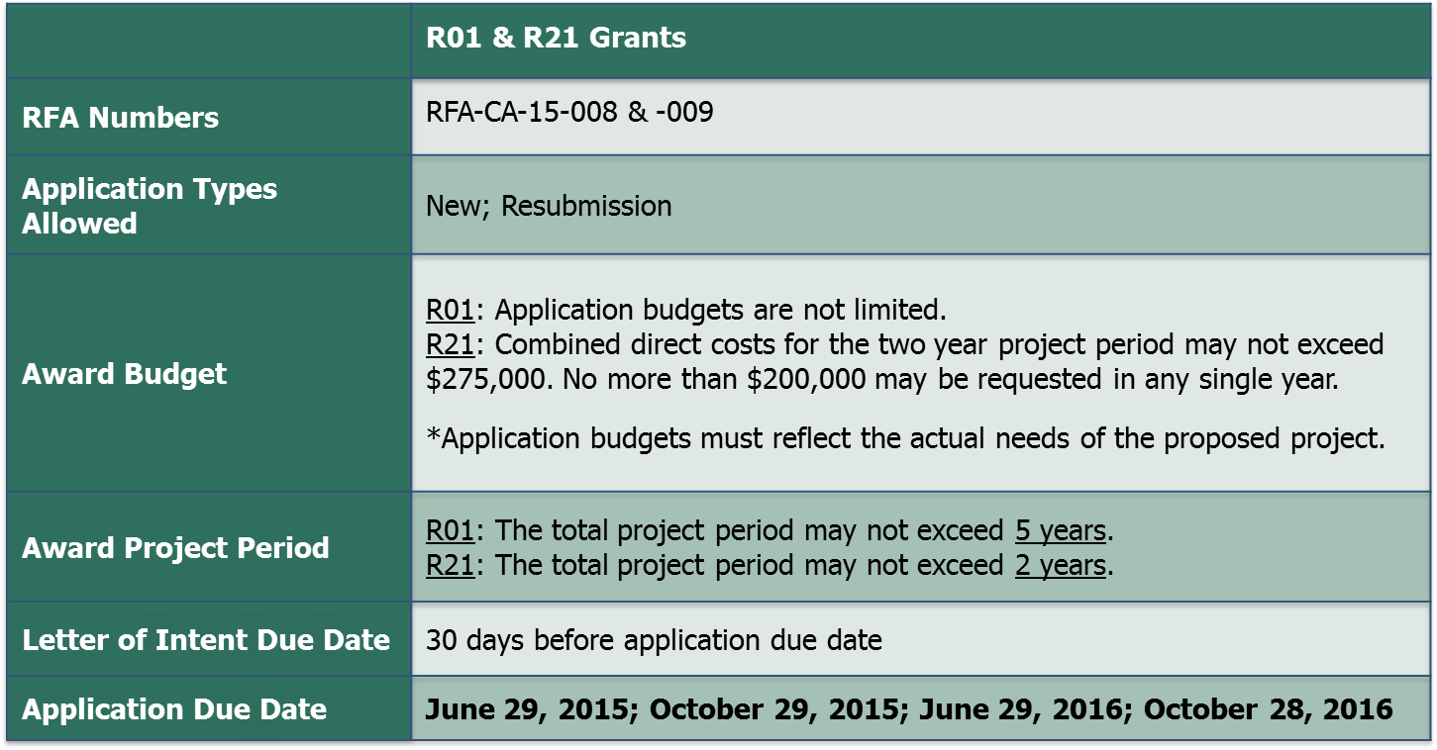
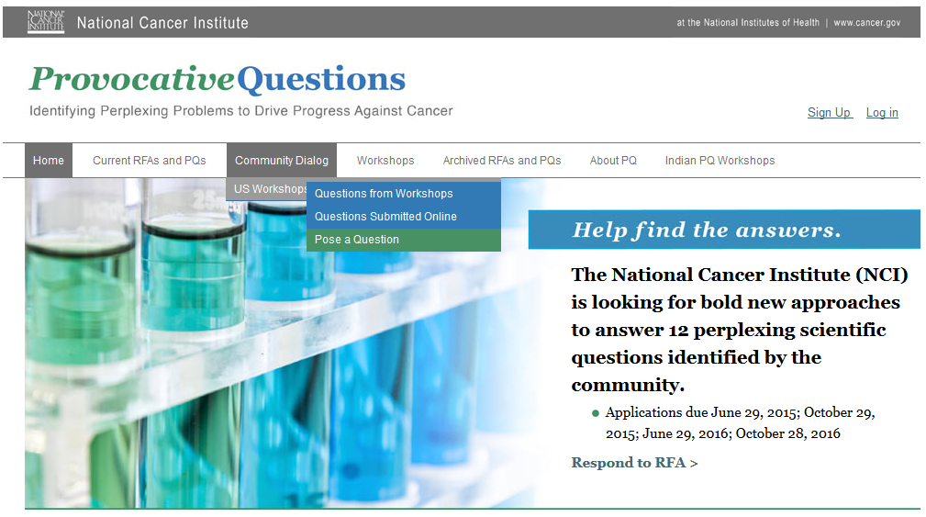
Join the Team! Current Funding Opportunities
provocativequestions.nci.nih.gov
Emily Greenspan, Ph.D.
PQ Program Director
emily.greenspan@nih.gov
Notes:
PQ went global, with workshops held in India.
Encourage you to check the website. Exciting times for PQs, set of 12 questions new questions and RFAs were posted at the end of March.
Can still submit questions on the website (incorporated into previous PQs).
Will be speaking on the PQs in a Meet the Experts session in the NCI Exhibit (#601)…today at 2:30 pm

